Slide 1


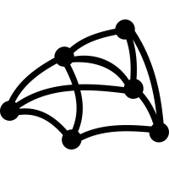
Blunder An Interactive Mesh Manipulator
By QuadrupleThreads

Slide 2
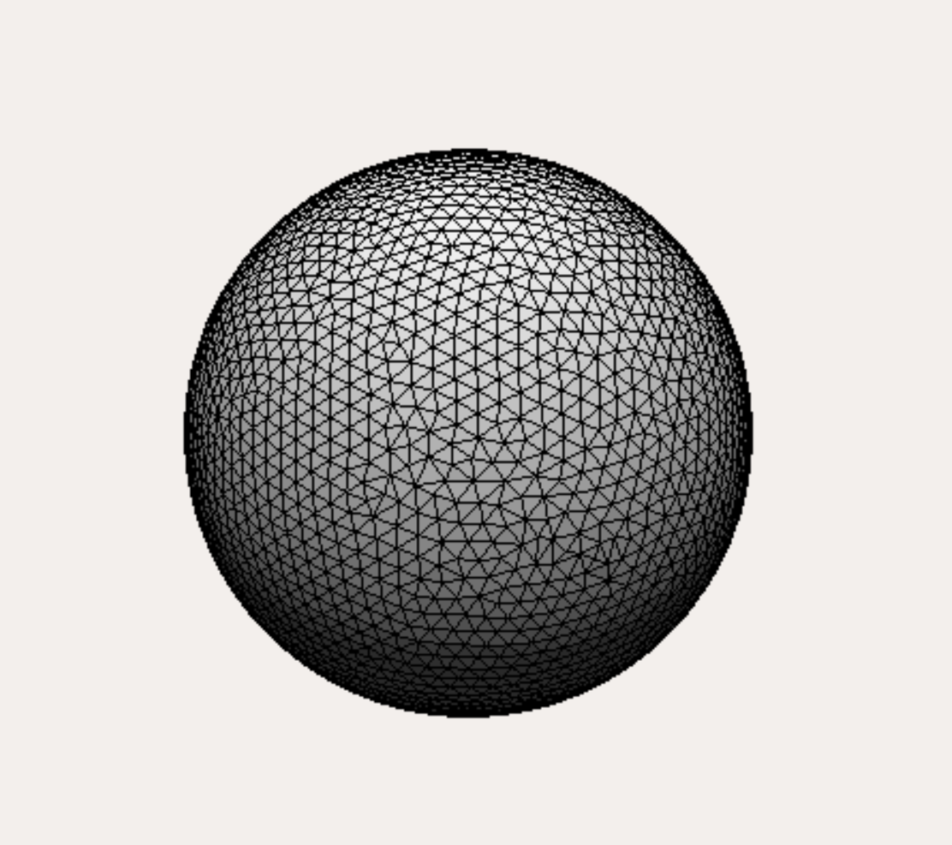
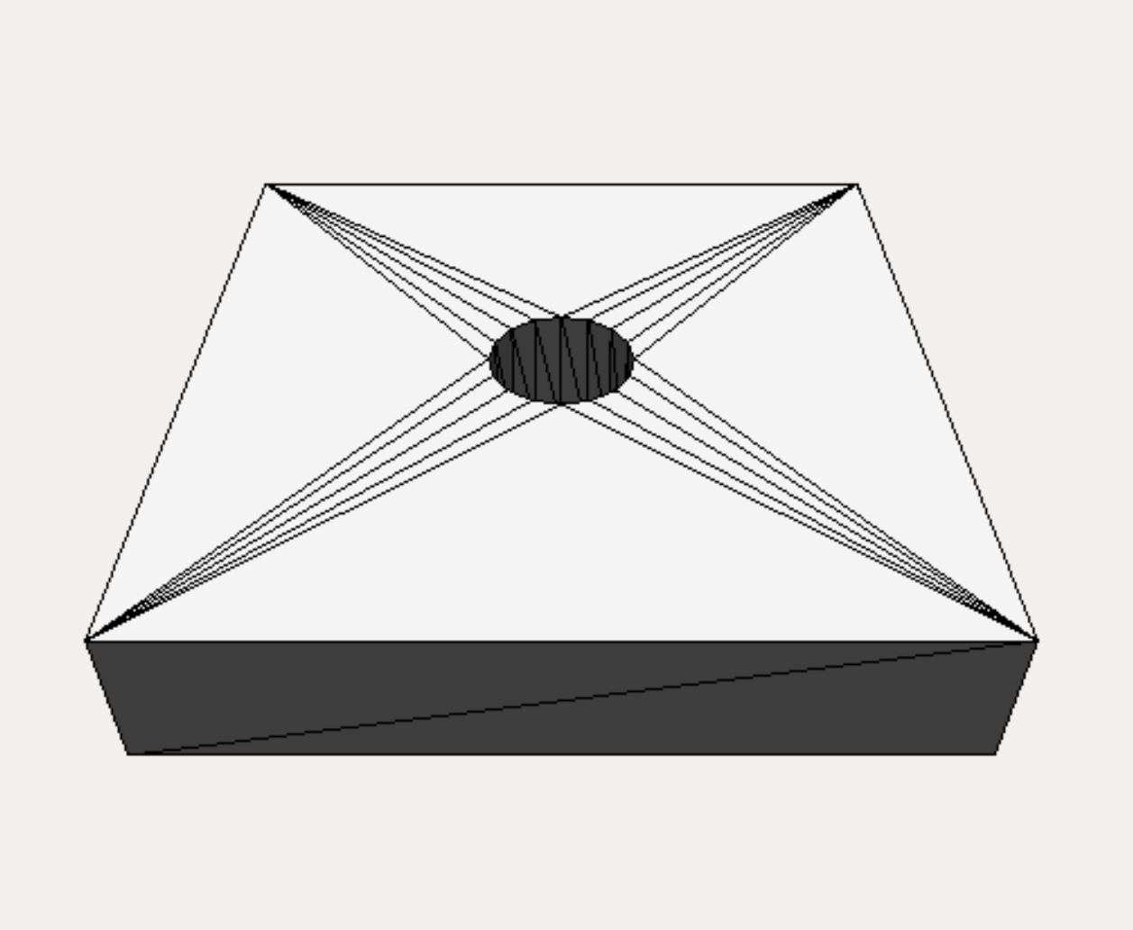
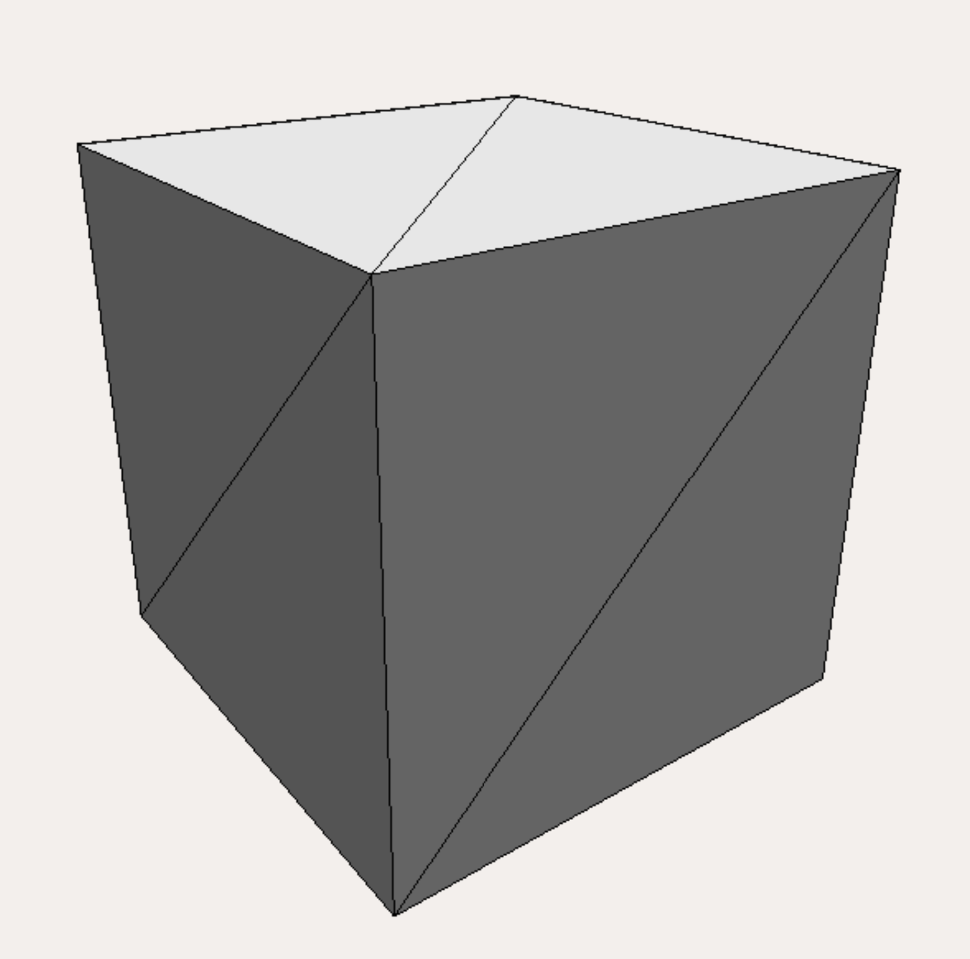
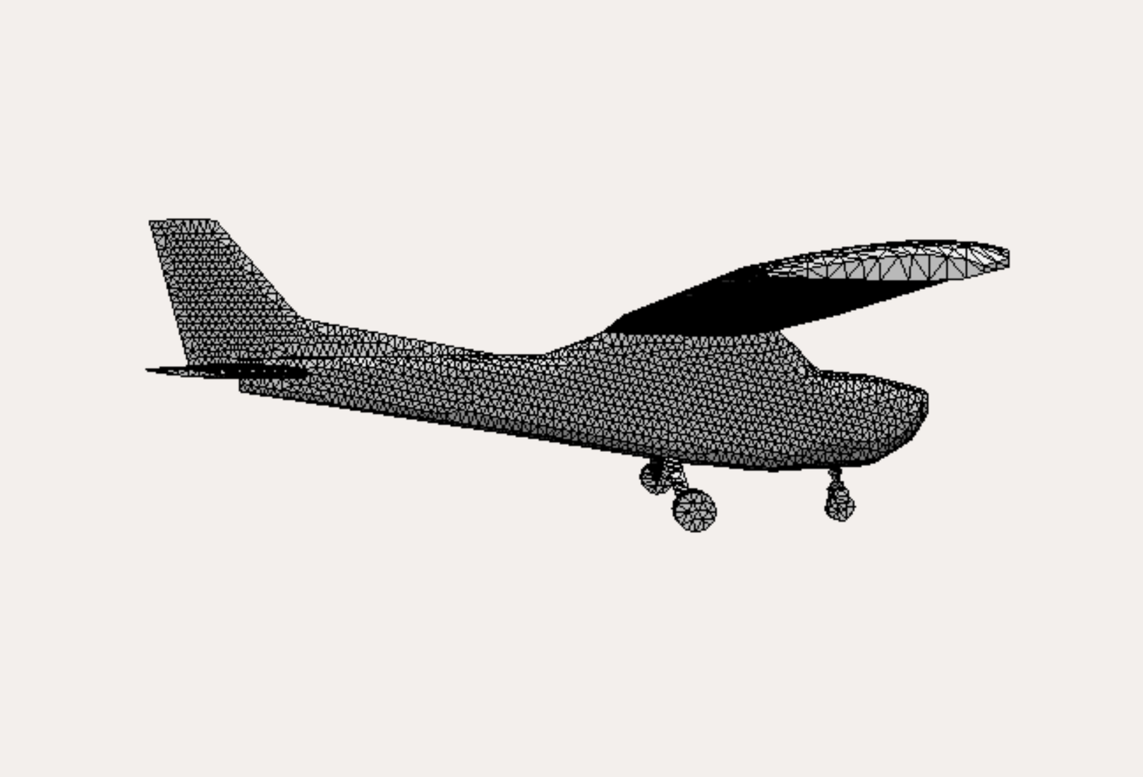
What is Blunder?
A lightweight, intuitive, user-friendly mesh manipulation software to edit STL files
Users can import STL files or select from a set of primitive shapes:
Sphere
Plate
Cube
Includes built-in Laplacian deformation and mesh smoothing
Export STL feature for any modifications made
Users can pan, rotate, and zoom mesh rendering

Slide 3




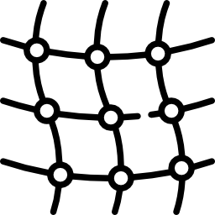
The Blunder Dev Team
Sparsh Garg
Laplacian Deformation
Gabriel Prado
STL Management
Sky Song
Smoothing+Integration
Nate Salazar
Rendering
Justin Soza
UI

Slide 4
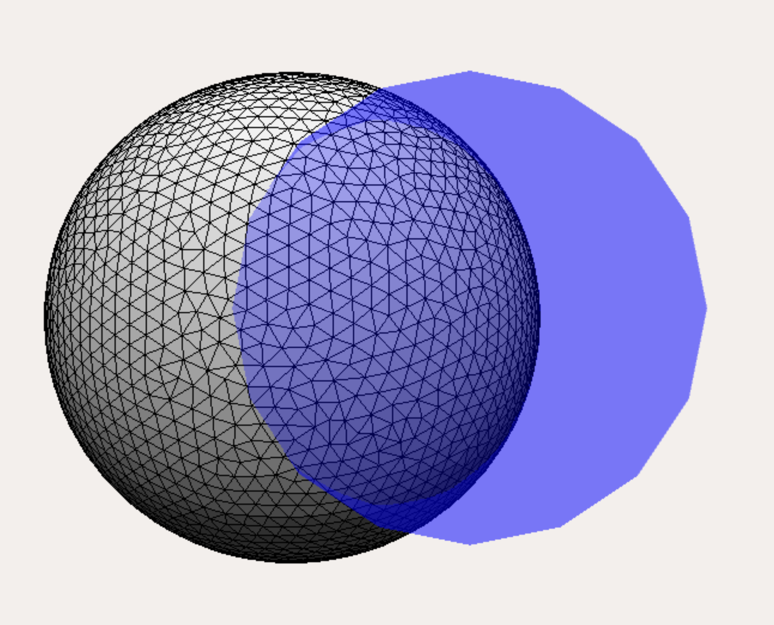
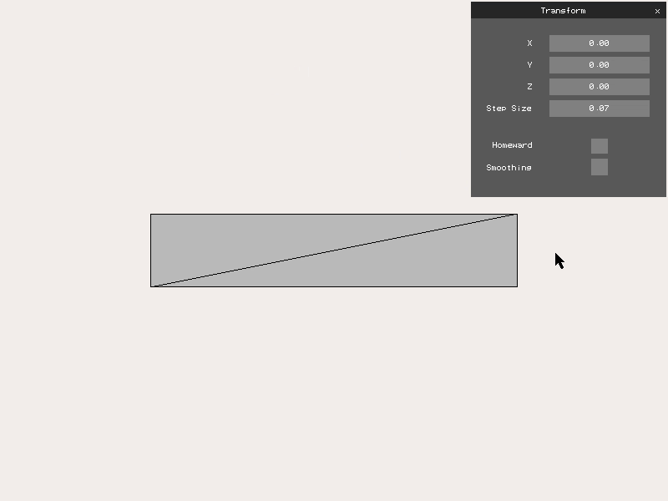
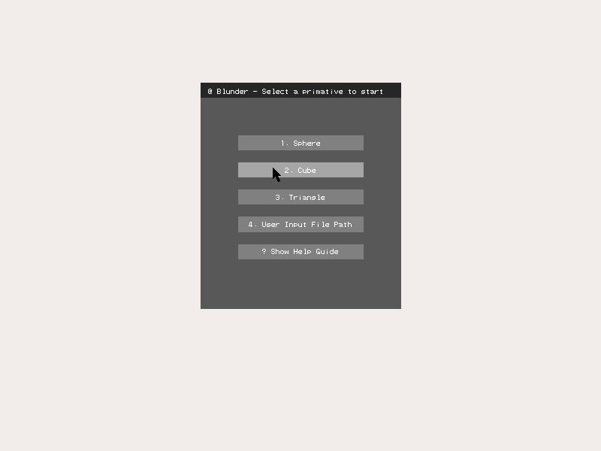
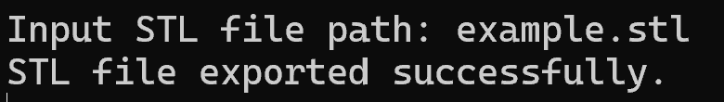
Major UI Components
Close and reopen executable to work on a new mesh

Slide 5


Keyboard and Mouse Controls
x: move selected node in +x
Ctrl+x: move selected node in -x
y: move selected node in +y
Ctrl+y: move selected node in -y
z: move selected node in +z
Ctrl+z: move selected node in -z
r: reset modifications
c: clear node selection
h: return to original rendering view
s: toggle smoothing tool
Ctrl+s: export modifications
Arrow keys: rotate mesh
Mouse wheel: zoom in/out
Left click: select node
Left click+hold: smooth if toggled
Mouse wheel down: pan

Slide 6
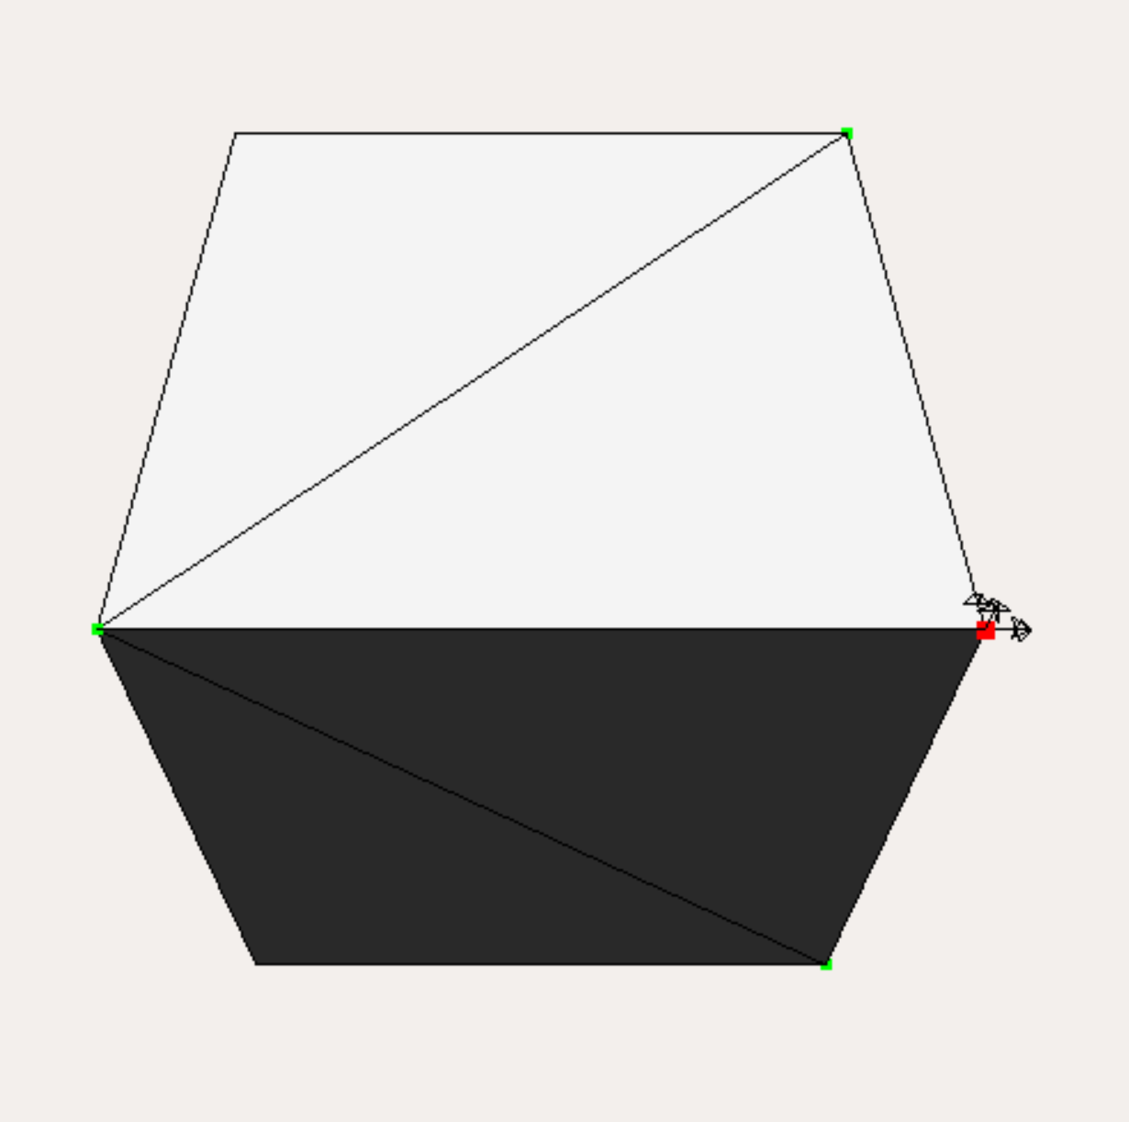
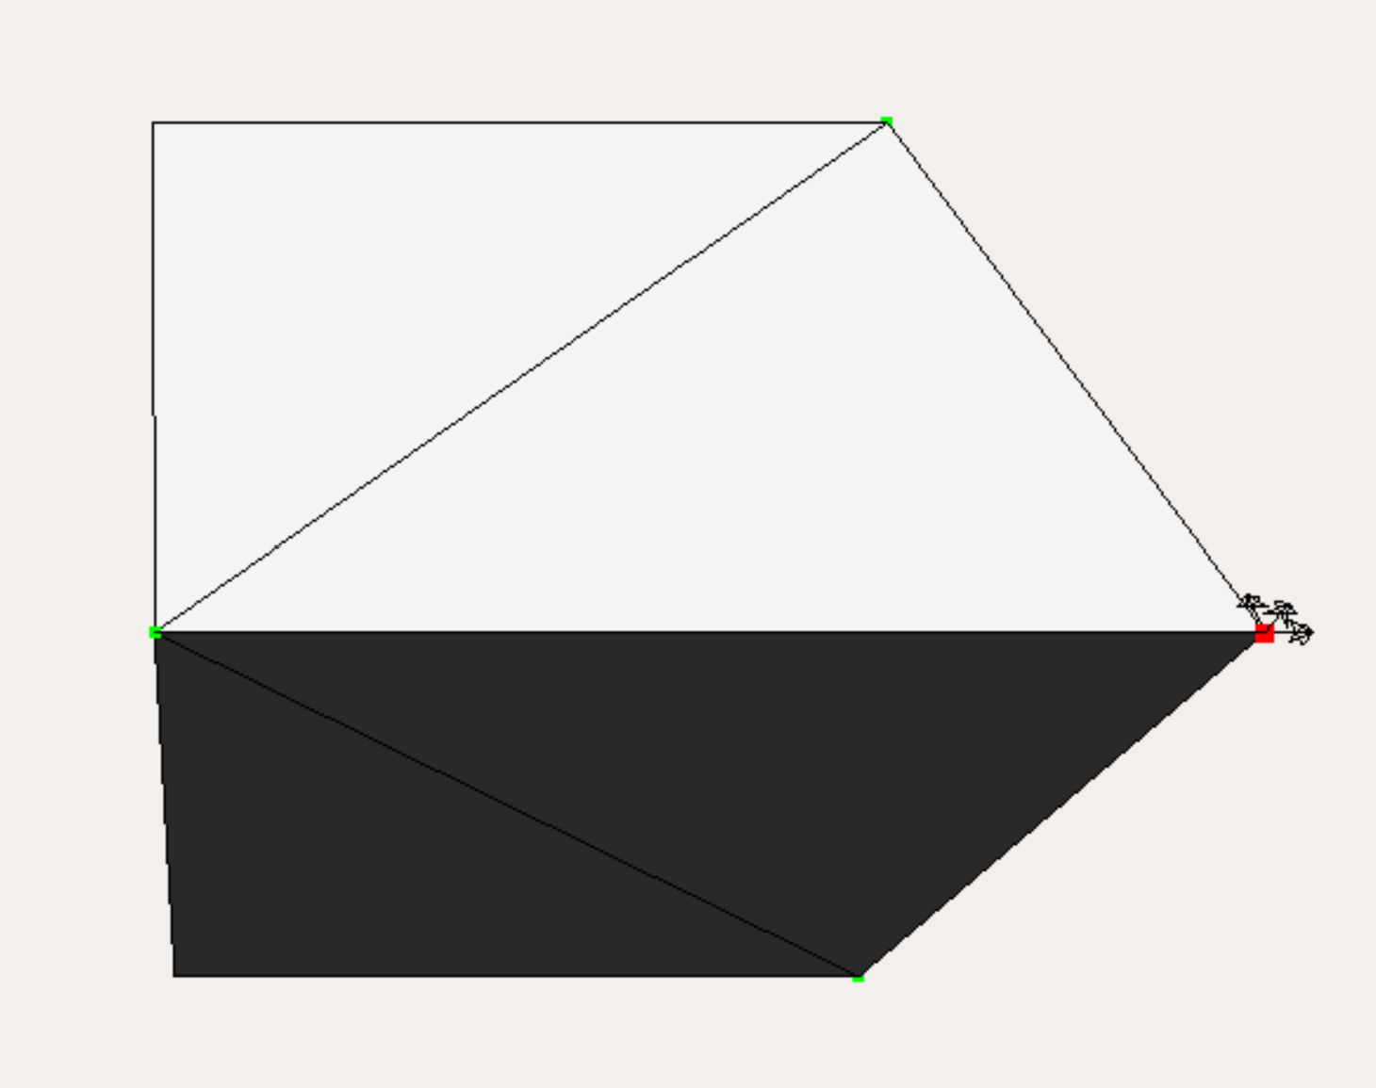
Laplacian Deformation
Implemented a vanilla Laplacian Editing class which takes user inputs in the form of control points and apply deformation to the whole mesh with anchor points

Slide 7
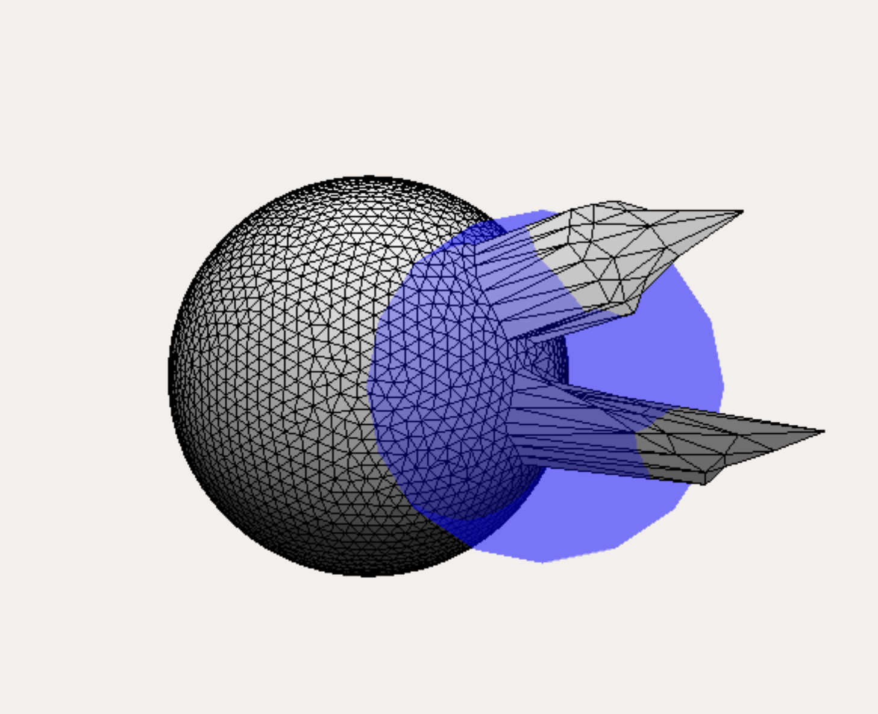
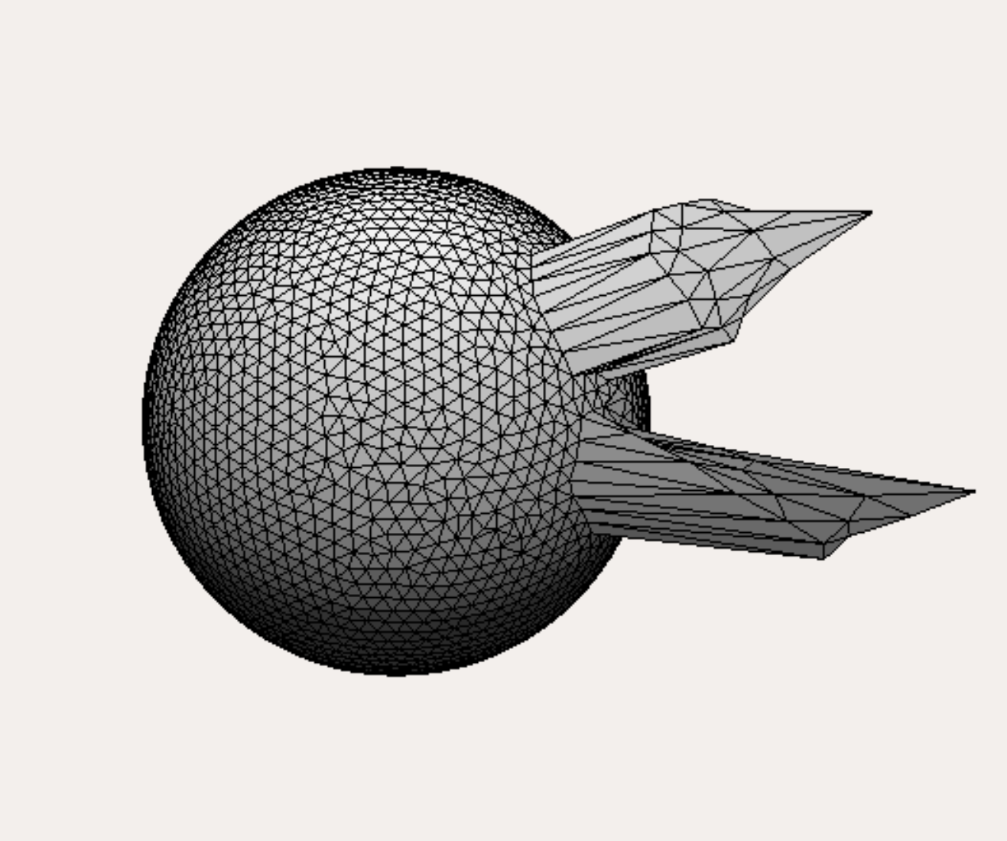
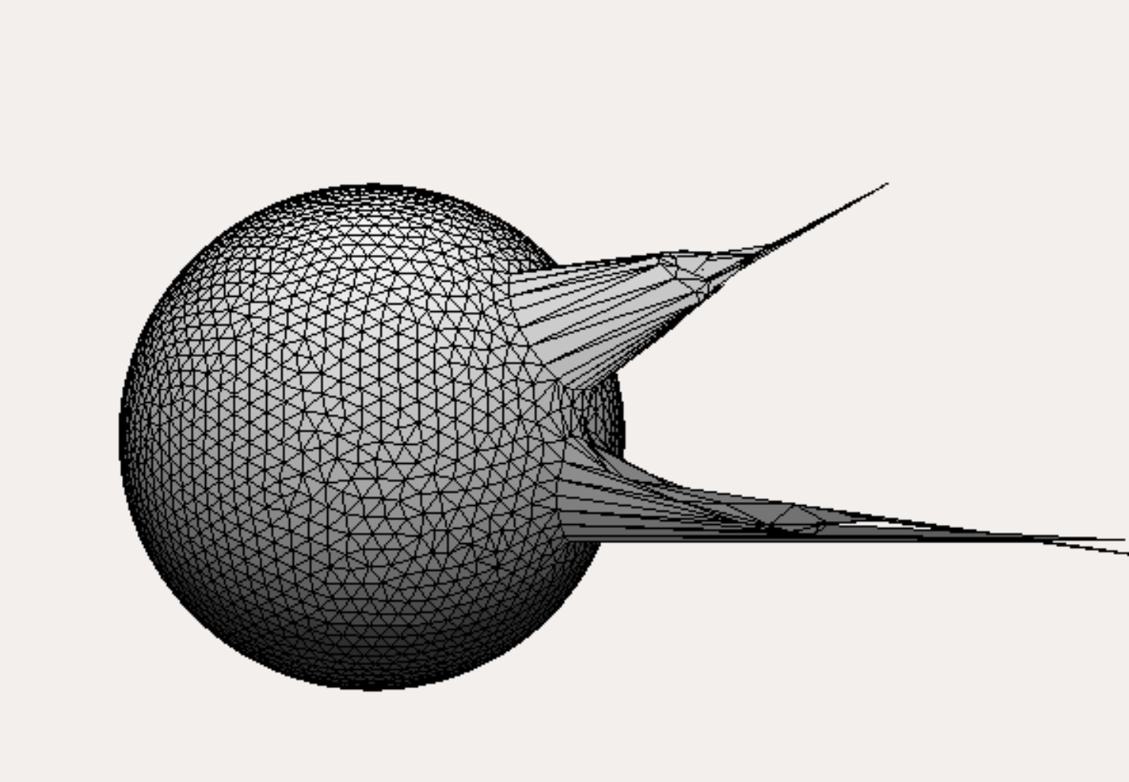
Mesh Smoothing
Toggling smoother creates a movable blue sphere of influence, nodes within sphere are smoothed

Slide 8
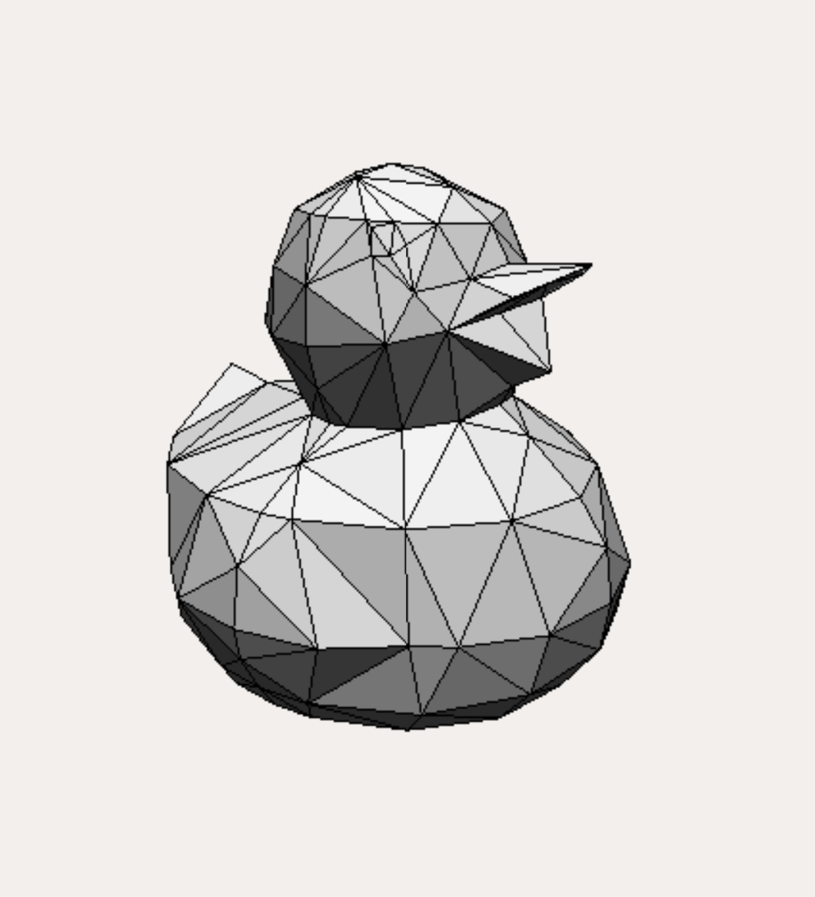
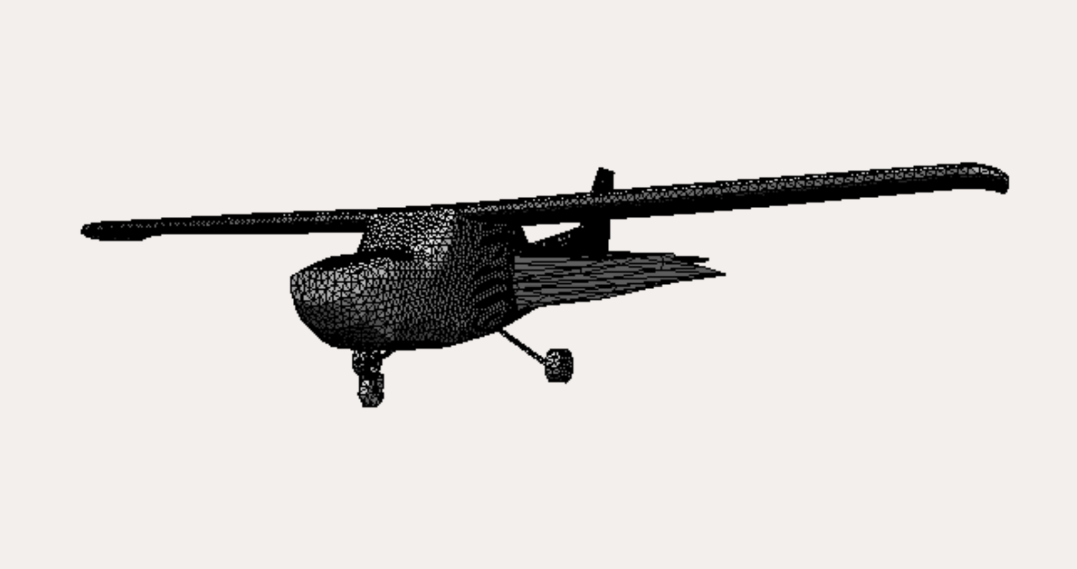
Why Blunder?
Blunder is fast and very simple to use
Great for quick ideation and prototyping
Allows for ideas to be shareable (STL exporting)
Laplacian deformation is an important feature of most 3D mesh software
Specific mesh smoothing allows for more control of ideation

